Slide 1
Using Top-Down Greedy Strategy algorithms to build, compare, and apply decision trees to different problem sets.
By
Karan Shah, Ameya Gidh
Mattia Contestabile, Jose Lou

Slide 2
Agenda
Introduction
Deep Analysis
ID3
C4.5
CART
Conclusion
Summary
Areas of growth

Slide 3
Introduction
The greedy approach is designed to either maximize or minimize the heuristic function.
In doing so, it behaves by selecting the ‘current best option at every step of the function. However, this does not mean it will overall optimize the algorithmic process. I
It is important to mention, that this greedy algorithm only moves towards one direction. What it does mean is that it does not retract to its previous position.
When comes in analyzing a top-down approach, we go from a more general case to a specific case. In a top-down fashion, we build a tree starting from a root node, and then we expand the tree at every single level. The criterion for expanding the tree is from choosing what is best at the current instance.

Slide 4
WHAT IS A DECISION TREE?
Supervised
Unsupervised

Slide 5
Components of a Decision Tree
Root node
Node purity
Decision Node
Leaf Node

Slide 6
Decision Trees
What is a Decision Tree
What we did
Why this project

Slide 7
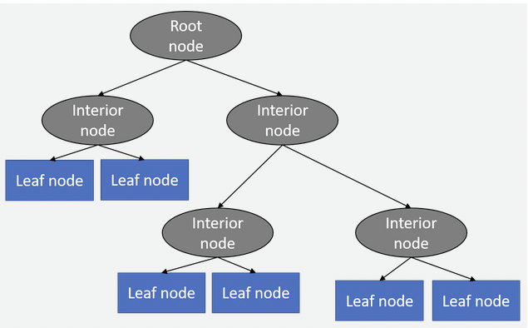
Decision Tree

Slide 8
ID3
Iterative Dichotomiser 3

Slide 9
ID3
Hypothesis space
Inductive Bias
Information Gain

Slide 10
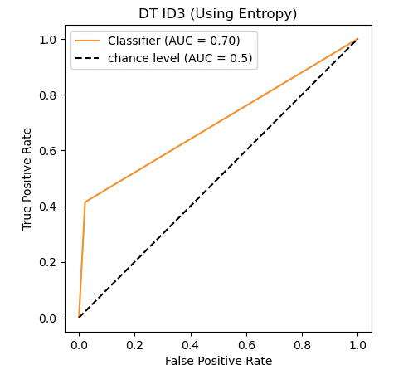
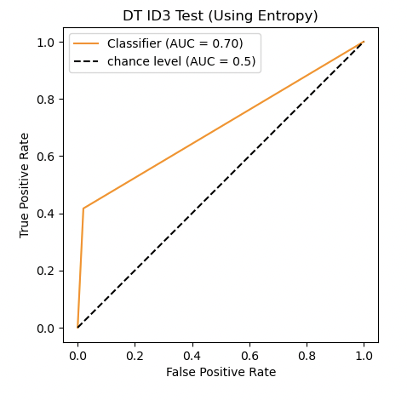
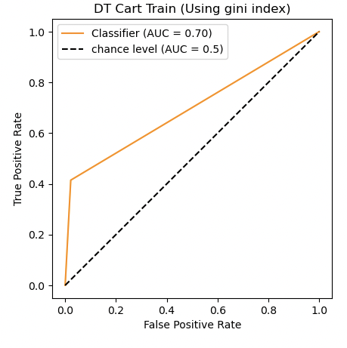
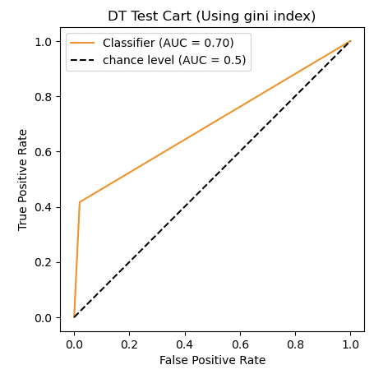
ID3 – ROC Curve
(ROC Curve for ID3 Train)
(ROC Curve for ID3 Test)
(ROC Curve for Cart Test)
(ROC Curve for Cart Test)
Sarang Narkhede, “Understanding Confusion Matrix,” Medium (Towards Data Science, June 15, 2021), https://towardsdatascience.com/understanding-confusion-matrix-a9ad42dcfd62.

Slide 11
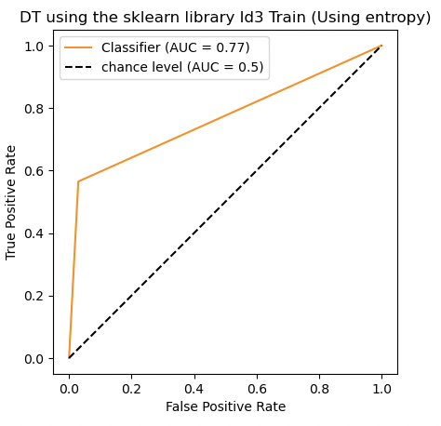
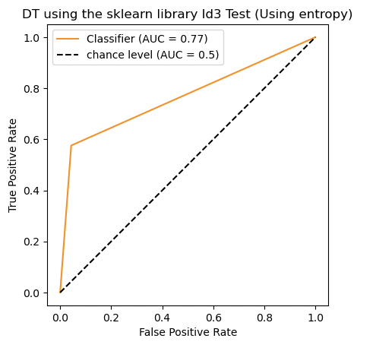
ID3 - Sklearn
(Decision tree using Sklearn)
(Decision tree using Sklearn)
Sarang Narkhede, “Understanding Confusion Matrix,” Medium (Towards Data Science, June 15, 2021), https://towardsdatascience.com/understanding-confusion-matrix-a9ad42dcfd62.

Slide 12
C4.5

Slide 13
C4.5
As mentioned in the above paragraph, C4_5 is an extension of the ID3 algorithm. But differently than ID3, C4_5 does not need to have its input dataset to be binarized and it can handle both numerical and discrete features.

Slide 14
CART
Classification and Regression Tree

Slide 15
CART
Following to our next algorithm, CART can be found to follow a similar structure to C4_5. However, the difference that distinguishes these two algorithms can be found in the “splitting creation for selection attribute.” As aforementioned, CART differently than ID3 uses GINI index as a reference for the splits it will execute. Its time complexity is calculated by also O(mn log₂ n) “where m refers to the attributes and n to the observations.”
Max A. Bramer, Artificial Intelligence XXXV: 38th SGAI International Conference on Artificial Intelligence, AI 2018, Cambridge, UK, December 11-13, 2018: Proceedings (Cham: Springer, 2018).
Max A. Bramer, Artificial Intelligence XXXV: 38th SGAI International Conference on Artificial Intelligence, AI 2018, Cambridge, UK, December 11-13, 2018: Proceedings (Cham: Springer, 2018).

Slide 16
CART ROC Curve
(ROC Curve for CART Train)
(ROC for CART Test)
Sarang Narkhede, “Understanding Confusion Matrix,” Medium (Towards Data Science, June 15, 2021), https://towardsdatascience.com/understanding-confusion-matrix-a9ad42dcfd62.

Slide 17
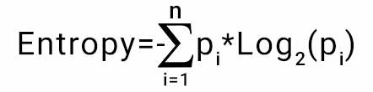
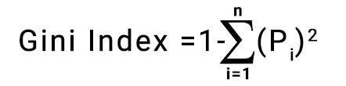
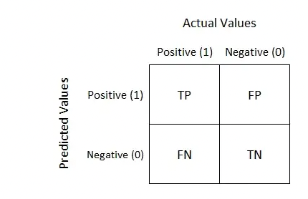
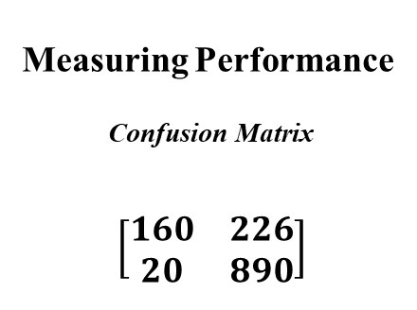
Entropy and Gini Index
Measuring Performance
Confusion Matrix
$$\left[\begin{matrix}160 & 226 \\ 20 & 890\end{matrix}\right]$$
Sarang Narkhede, “Understanding Confusion Matrix,” Medium (Towards Data Science, June 15, 2021), https://towardsdatascience.com/understanding-confusion-matrix-a9ad42dcfd62.

Slide 18
Conclusion
Given the data we have finally elaborated, the avenues for future research concentrate on reducing the size of the Decision Tree for more robust result. For achieving that we use pruning, that reduces the size of a Decision Tree and its complexity. Better approaches include using Random Forest algorithm, that uses a combination of many decision trees and depending on the number of votes it marks the right the label to choose. In a random of forest, we make use of bagging which bootstrap aggregation then each model is generated by using the sample with replacement this is also row sampling. Thus, since we combine many results together to reach the output of majority voting, that is the reason why it is also known as aggregation.

Slide 19
Thank you https://youtu.be/QxYMjJxueTI - video youtube

